Slide 1
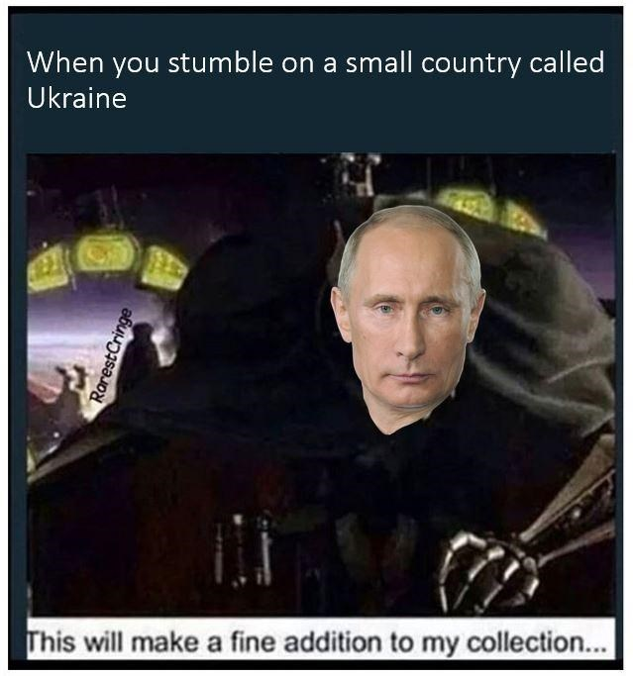
Day 2 – 11:30 Project Progress Report -Tympe-
Logan Schlick, Daniel Marin, Kyle Rimando, Sonny Pizzo, Shane Ghuste

Slide 2
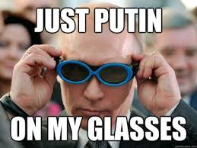
Front end progress…
Had unnecessary trouble with the text box, but its fixed
Made single background for now
Front end designers:
Daniel Marin
Sonny Pizzo

Slide 3
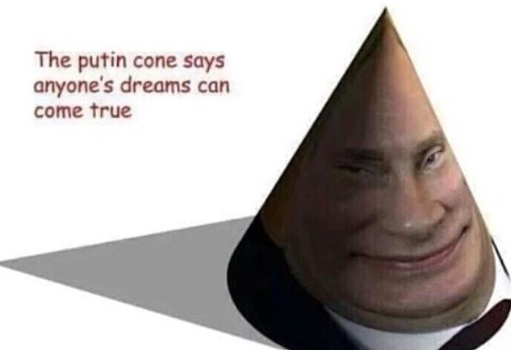
Back end progress…
Progress is slow but its still progress
Created a scoreboard, but having trouble with the coding
Messing with other abilities of the game
Back end designers:
Logan Schlick
Kyle Rimando

Slide 4
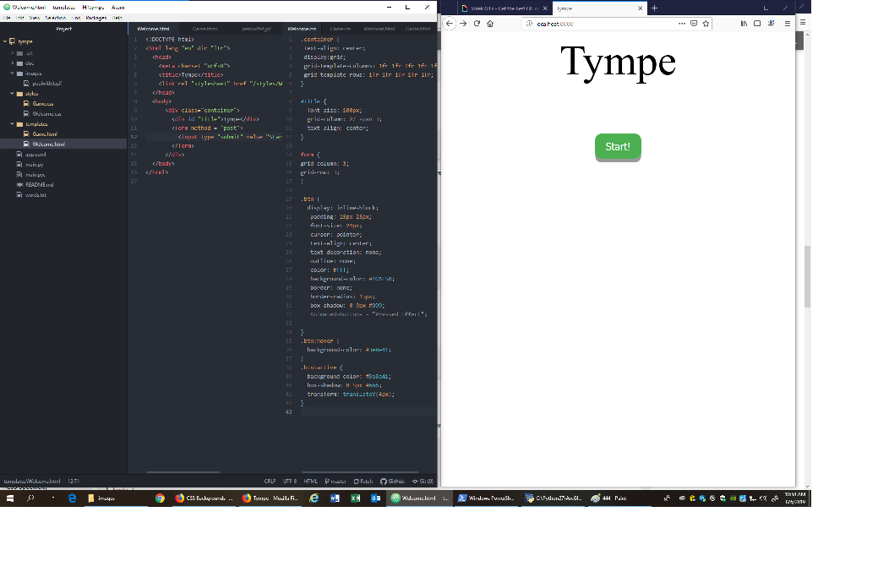
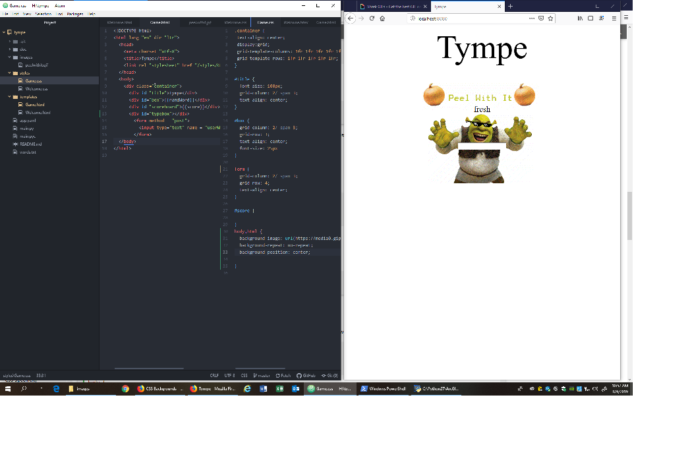
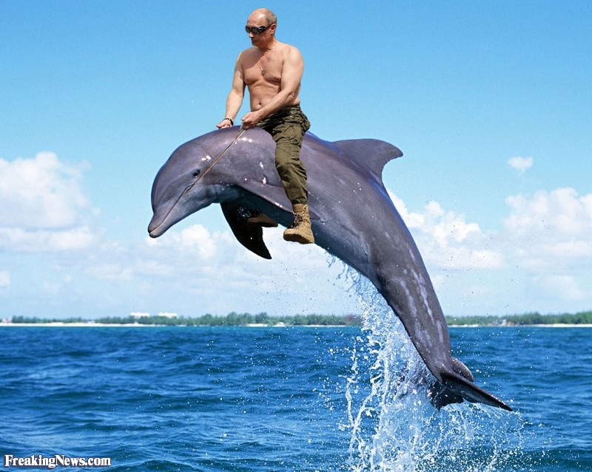
Progress is progress…

